Slide 1
Humboldt Haven IT
Dean Callahan, Jaztin Marasigan, Nathan Watson

Slide 2
Scenario
Humboldt Haven provides expert computer repair and IT support services to both businesses and individual clients. We offer services such as virus removal, hardware upgrades, software troubleshooting, and network setup. Humboldt Haven also offers maintenance contracts for small businesses only, providing monthly check-ups, system updates, and emergency support.
Notes:
Nathan

Slide 3
Business Rules
Small Selection:
Multiple customers can submit one ticket and customers can submit multiple tickets.
Only 1 Humboldt Haven IT business location exists.
Multiple technicians can work on one ticket and technicians can be assigned multiple tickets.
Every customer must have a unique customer ID, and this field cannot be null.
Every employee must have a unique employee ID which cannot be null.
Inventory quantity must always be a non-negative integer.
Employee salary must always be positive.
Method of payment must match the approved payment methods (cash,debit,credit,check).
Notes:
Nathan

Slide 4
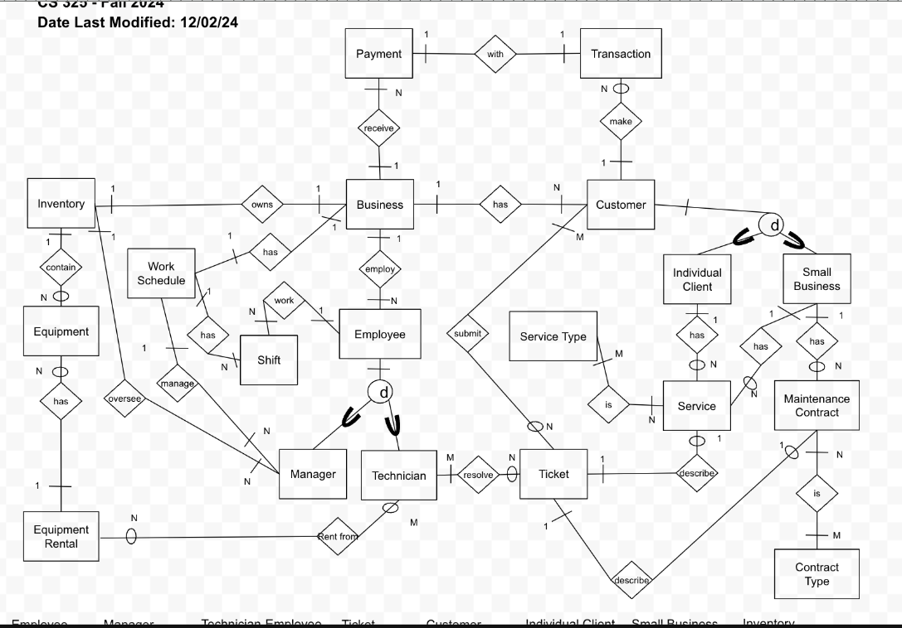
ER Diagram
Attribute List Small Selection:
Business
—---------
BusinessID
TaxID
DBA
Address
Hours_Operation
Technician-Employee
—---------
TechnicianID
TechCertifications (mv)
TicketsCompleted
Manager-
Employee
—---------
ManagerID
ManagerBonus
Employee
—---------
EmplID
EmplSalary
EmplFName
EmplLName
EmplEmail (mv)
EmplPhone (mv)
EmplAddress
Hiredate
Customer
—---------
CustomerID
CustEmail (mv)
CustPhone (mv)
CustAddress
Individual Client-
Customer
—---------
ClientID
ClientFName
ClienttLName
Small Business-
Customer
—---------
SmallBusinessID
TaxID
DBA
Notes:
Dean

Slide 5
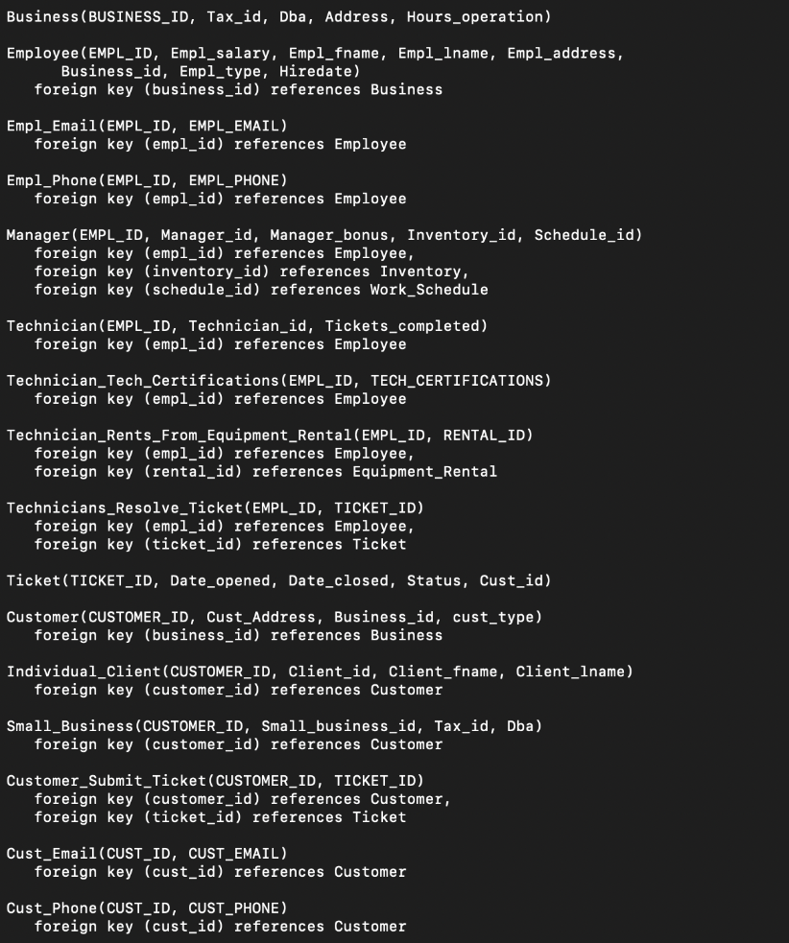
Database Schema
Functional dependencies with primary keys
Normalized attributes like emails, phone numbers, certificates
Notes:
Dean

Slide 6
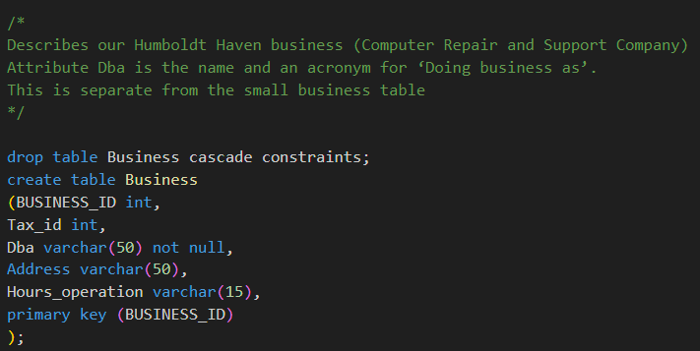
SQL statements for database construction and data population
Notes:
Jaztin

Slide 7
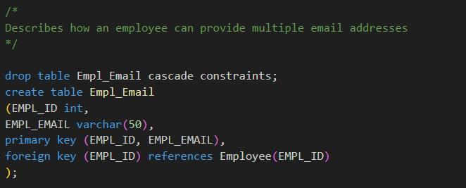
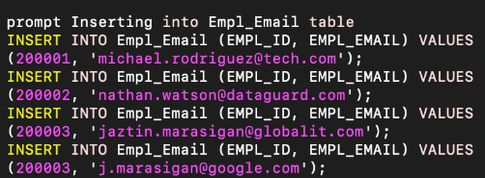
SQL statements for database construction and data population
Notes:
Jaztin

Slide 8

Queries

